Slide 1

Microsoft Cloud Solution Center
Module 2
Notes:
Slide title: Microsoft Cloud for Financial Services
Welcome and thank you for joining me today in this overview of the Microsoft Cloud for Financial Services.
<click>

Slide 2





Know the Solution
Packaging and Pricing
Features and Solution Dependencies
Introduction to Microsoft Cloud Solution Center
Post deployment configurations
Notes:
In this module, we will cover
FSI packaging and pricing,
Then we will delve into understanding FSI features and solution dependencies.
This will be followed by a deep dive on our Industry clouds offering, that is Microsoft Cloud Solution Center
And then we will move over to Post deployment configurations

Slide 3
Getting Started
1
2
3
4
SELECT
Select Microsoft Cloud for Financial Services capabilities for your enterprise
PROCURE
Purchase Microsoft Cloud for Financial Services license
Obtain licenses for other Dynamics 365, Power Platform and Microsoft 365 components as needed for dependencies of selected features
DEPLOY
Dynamics , Power Platform and M365 components through Microsoft Cloud Solution Center
CONFIGURE
Solution configurations for each module
Notes:
Before you begin on your Microsoft cloud for financial services journey, you should follow 4 steps –
First to – Select the right FSI capabilities for your enterprise. Since FSI is split into multiple capabilities, you might choose to work with a subset or whole of the FSI, depending on what you see fit for your use cases.
Then, depending on what you choose, you will move on to Procuring the right licenses. The FSI license is mandatory, followed by other underlying licenses in Dynamics, Power Platform and M365. As we progress today, you will understand the prerequisites and license dependencies of each FSI capability
Once your have procured the right licenses, you will then kickoff the deployment step.
<<Since FSI cuts across multiple clouds, the deployment steps are via Microsoft Cloud Solution Center for Dynamics, via Azure Portal for Azure components, and via M365 admin center for Microsoft 365 components. >>
And post deployment, there are solution wise mandatory and optional configurations that need to be done for each module. With that your journey from selection to configuration will be complete and you can begin working with your FSI setup.

Slide 4
Select and Procure | Cloud for Financial Services
Pricing Model
Microsoft Cloud for FSI |  | Per Tenant $20,000 per month
Purpose-built Industry IP | Unified customer profile | ●
 | Banking customer engagement | ●
 | Customer onboarding | ●
 | Collaboration Manager | ●
Customer Success | Industry-specific technical solution architects (CSA) | ● (up to 20 hours)
 | Specialized, industry focused customer support | ●
Benefits and Discounts | Compliance Manager (Trial) | Up to 25 premium assessments via 90-day trial of E5 Compliance/ Compliance Manager
Assurance Program (Seeded) | Assurance Program (Trial) | One time engineer guided assessment (Up to 2 hours)
D365 fraud protection (Seeded) | D365 fraud protection (Trial) | AP 50,000 transactions Limited PP and LP (5,000)
Notes:
MC-FSI SKU is priced at $20k/tenant/month. It includes all 4 new capabilities at one price point.
A customer does not need to use all of the features and, a Customer cannot just buy one of the capabilities as a standalone.
The SKU covers 3 specific areas – 1) Purpose built industry IP encompassing all FSI capabilities in the form of applications, connectors and configurations
2) Customer success benefits and Support services available 24/7 with unlimited access to technical resources and more
3) cloud benefits and trials that are a sampling of existing Microsoft offerings relevant to FSI industry, but they are not exclusively for FSI cloud like the 4 new capabilities. For example-
Trial access to industry cloud benefits and discount offering including M365 Compliance Manager (90 days), Financial Services Compliance Program (2 hours), and Dynamics 365 DFP (limited quantity).
Also note that the Azure services and any other dependencies are not included in the $20,000 per tenant/per month and need to be purchased separately based on the selected set of capabilities

Slide 5
Features and Solution Dependencies
● | Pre-requisite | ⧫ | Recommended
Industry Priority Scenario | Capability | Delivery Date | FSI add-on SKU | M365 |  | Power Platform |  |  | Microsoft Dynamics 365 |  |  |  |  | Microsoft Azure
 |  |  |  | M365 E3+ | MS Project | Power Apps | Power Automate | Power BI | Customer Insights | Customer Service Enterprise | Digital Messaging add -on | Sales Enterprise | Customer Voice (fmr. Forms Pro) | Azure Meters (See **)
 |  |  |  | Per user ($20) | Per user ($10) | Per user or per app ($10) | Per user or per flow ($15) | Per user or tenant ($10) | Per tenant ($1,500) | Per user ($95) | Per user ($75) | Per user ($95) | Per tenant | Metered
Differentiated Customer Experience | Unified Customer Profile | GA (Nov2021) | ● |  |  | ● | Included in Power Apps | ⧫ | ●
 | Banking Customer Engagement | Preview (Nov2021) | ● |  |  | Included in D365 Enterprise |  | ⧫ | ⧫ | ● | ● |  | 2,000 included
 | Customer Onboarding | GA (Nov2021) | ● |  |  | ● | Included in Power Apps | ⧫ | ⧫ | ⧫ |  | ⧫ | ⧫
Empower Collaboration | Collaboration Manager | GA (Nov2021) | ● | ● | ⧫ (post GA) | ● | Included in Power Apps
5
Notes:
This slide shows a summary of the industry priority scenarios mapped to the specific FSI capabilities alongwith the licensing dependencies. For example if you were looking to empower collaboration for your customer, you would map it back to the Collaboration Manager capability and note that the licenses required would be M365 E3+ and Power Apps alongwith obviously the FSI addon sku.

Slide 6
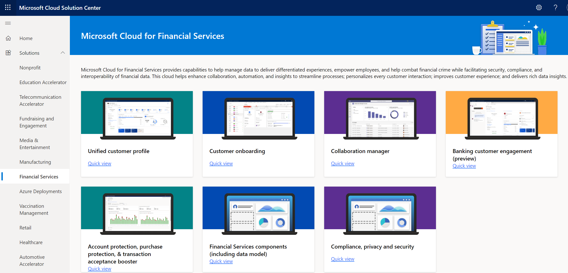
Deploy via Microsoft Cloud Solution Center
New portal-based experience to simplify industry cloud deployments
In-built licensing and pre-requisite checks to simplify deployment process
Unified deployment and configuration experience across multiple lines of apps
Prerequisites:
Enterprise has purchased Microsoft Cloud for Financial Services
User is a Power Platform Admin or Dynamics 365 Admin to deploy the solution
User has required licenses and dependent Dynamics 365, Power Platform and Microsoft 365 applications installed
6
Notes:
Now that we understand what licenses are required to get started, we will move to understand how to really deploy FSI.
Dynamics components-based installations can be now deployed through a new portal-based experience known as the Microsoft Cloud Solutions Center.
It is used to guide customers and partners through the deployment of capabilities for comprehensive Industry clouds such as FSI.
It is an orchestrator that simplifies the whole deployment process by checking licensing requirements and dependencies so that you don’t have to memorize the table you saw in the last slides ;)
It also brings in a unified deployment and configuration experience across multiple applications.
Just couple of prerequisites before you begin deployment using the Microsoft Cloud Solutions Center –
The enterprise should have purchased the FSI sku
The user logging into the Solution Center should have Power Platform admin or Dynamics 365 admin role to deploy FSI
User should also have the required licenses for FSI and dependencies

Slide 7
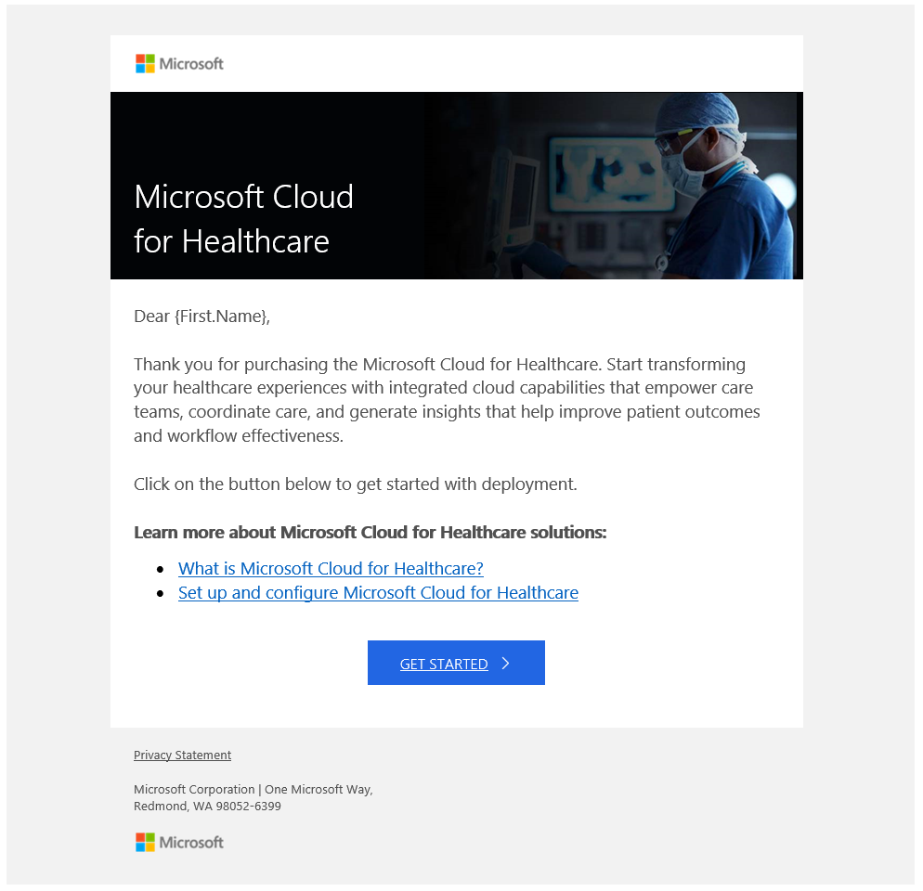
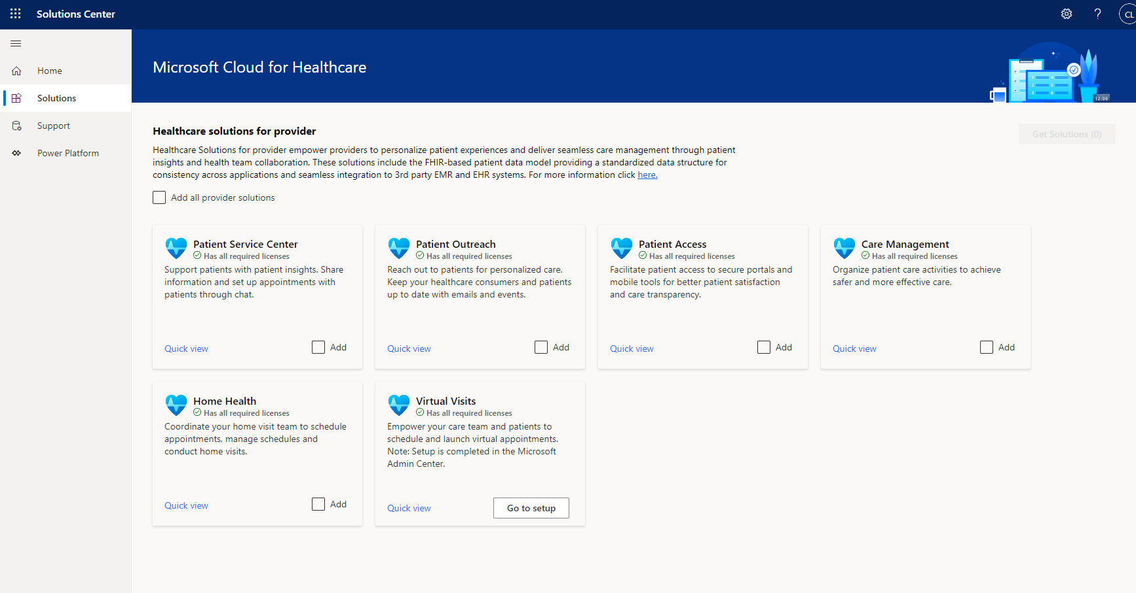
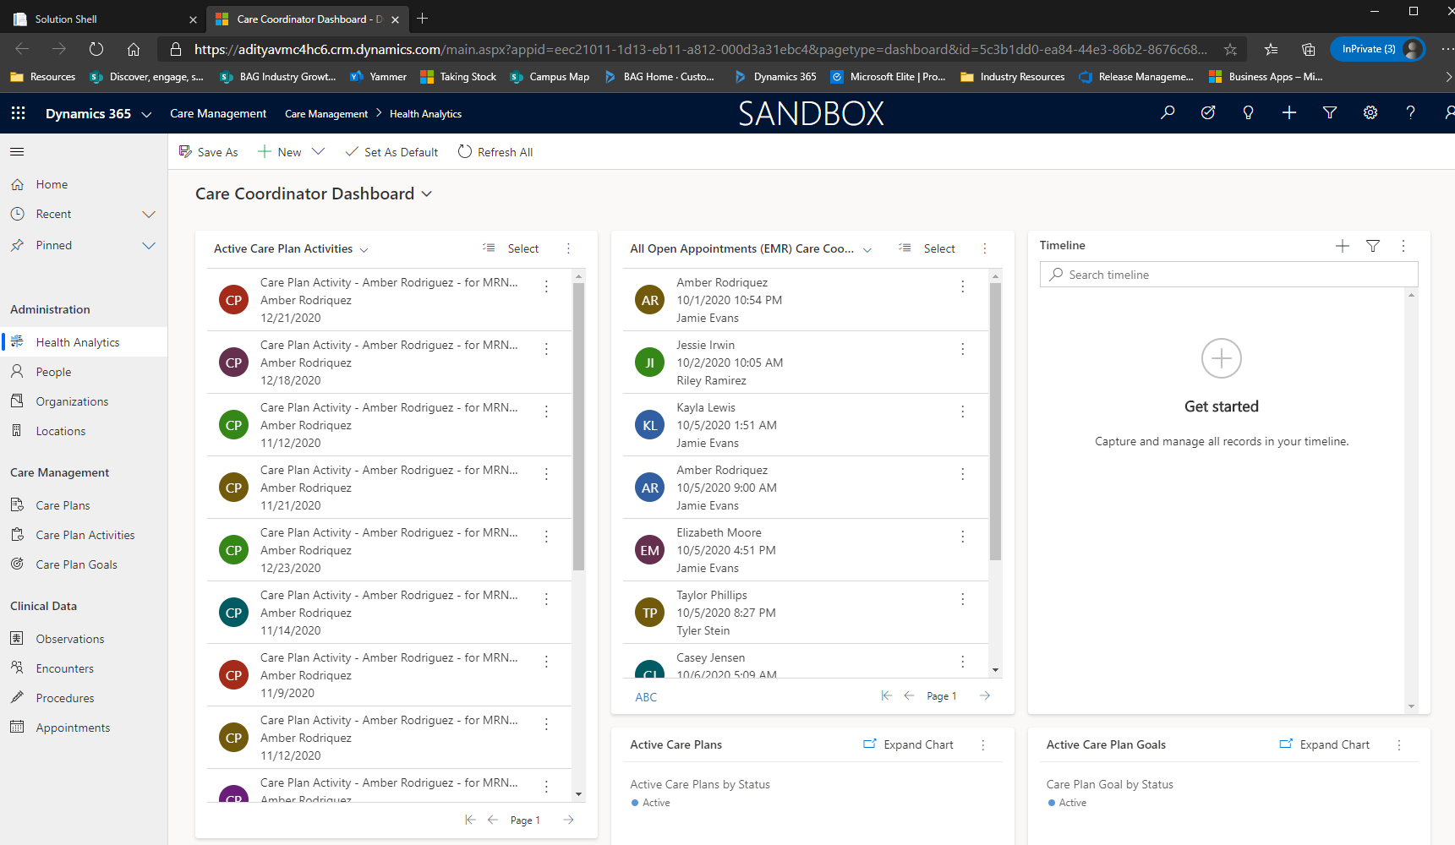
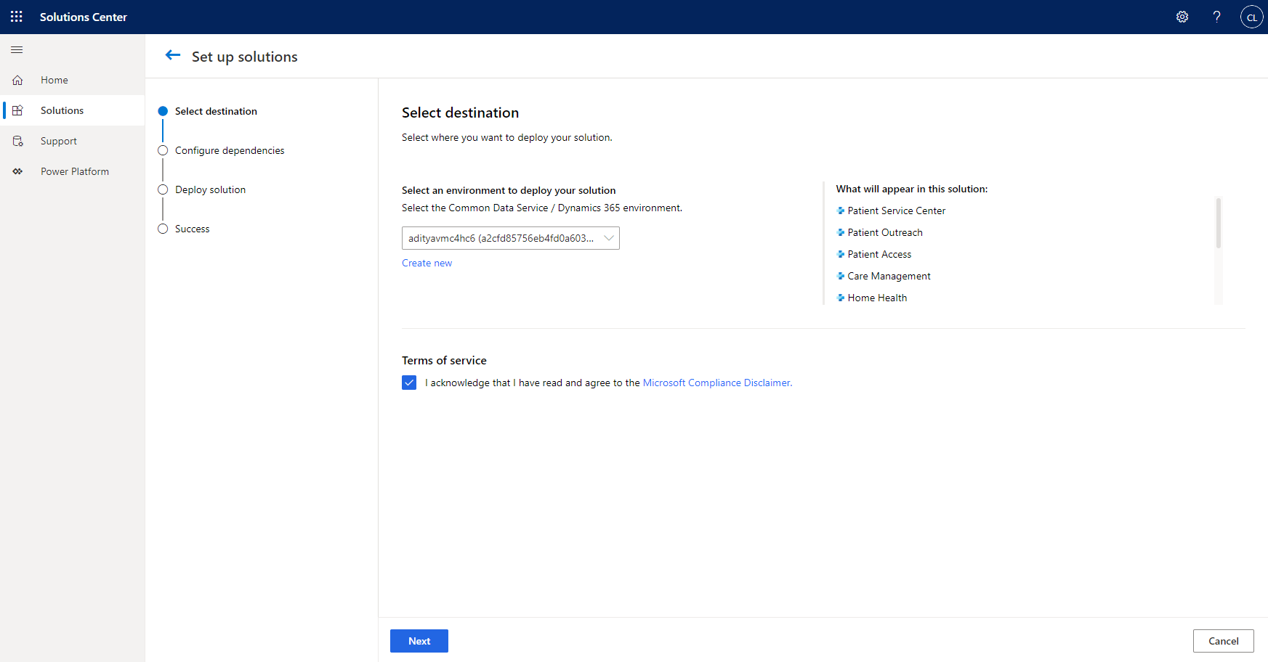
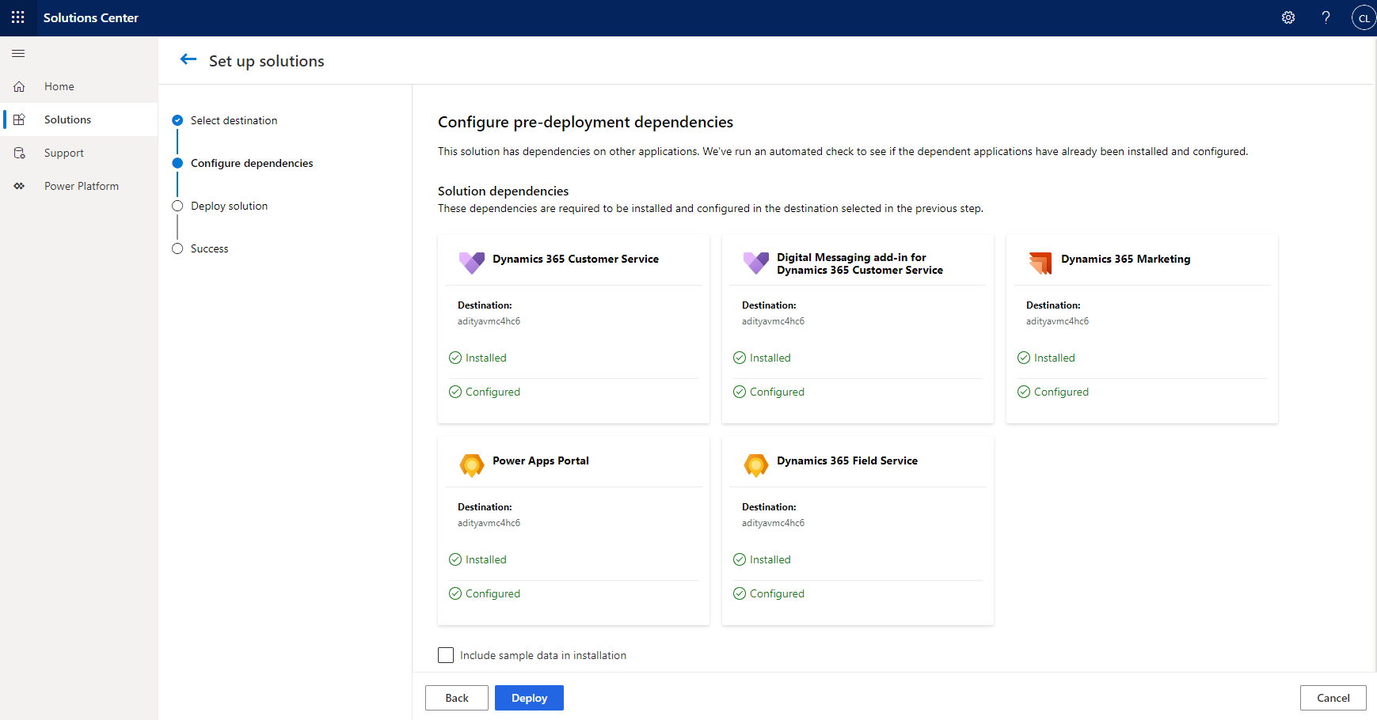
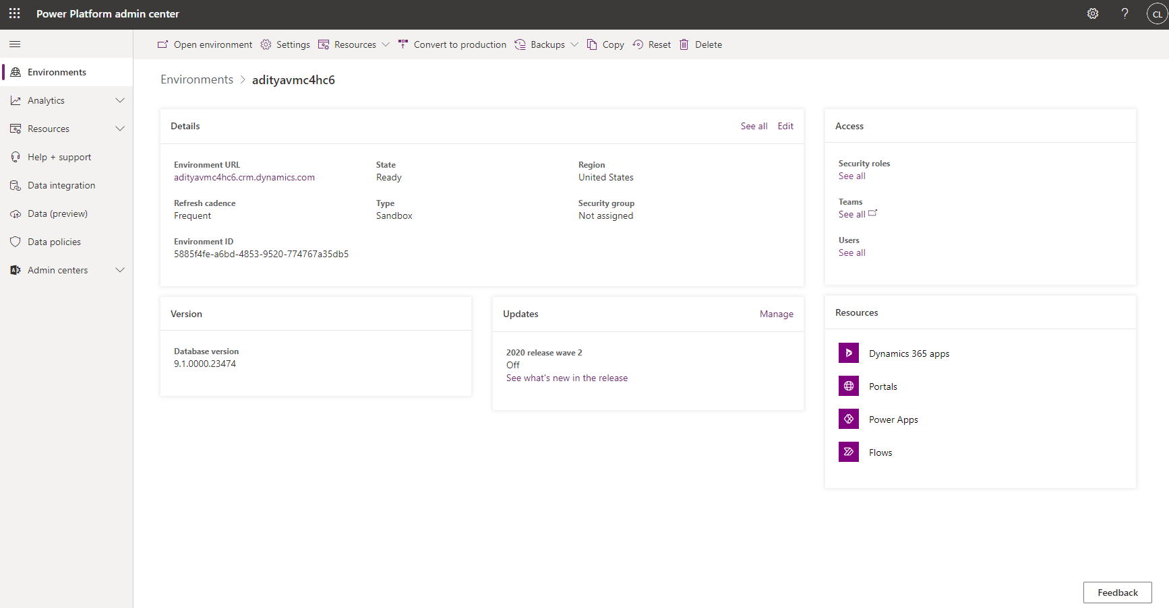
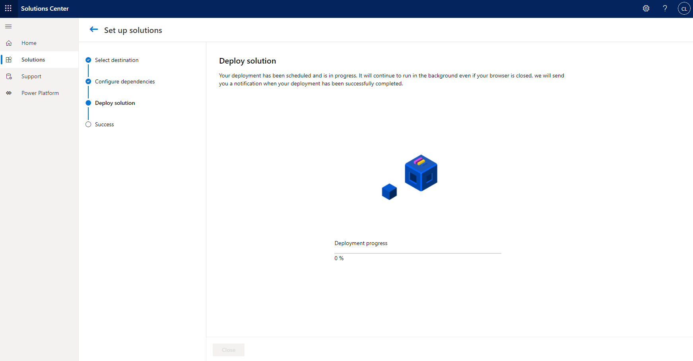
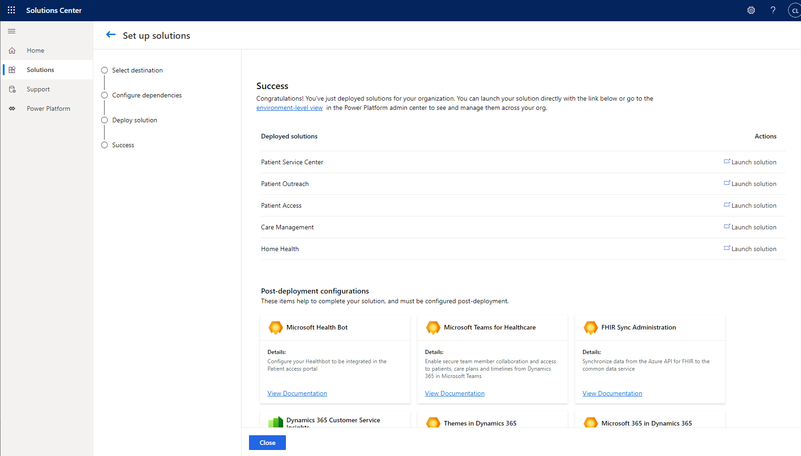
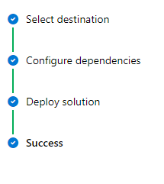
Deploy via Microsoft Cloud Solution Center
Post purchase mail
Microsoft Cloud Solution Center
Launch/Manage solution
7
Notes:
Now let us understand the steps to follow in deploying FSI components via Microsoft Cloud Solution center
First off, when you purchase the sku, you would be greeted with a post purchase mail which will have a link to Solution Center to begin your deployment process. Nevertheless you can also go to aka.ms/solutioncenter to begin your deployment once the purchase is complete.
Solution Center is extremely user intuitive and you will be able to guide yourselves through the installation steps on your tenant there.
Once the installation is triggered, you can view the status in Power Platform Admin Center and launch your FSI applications once complete.

Slide 8
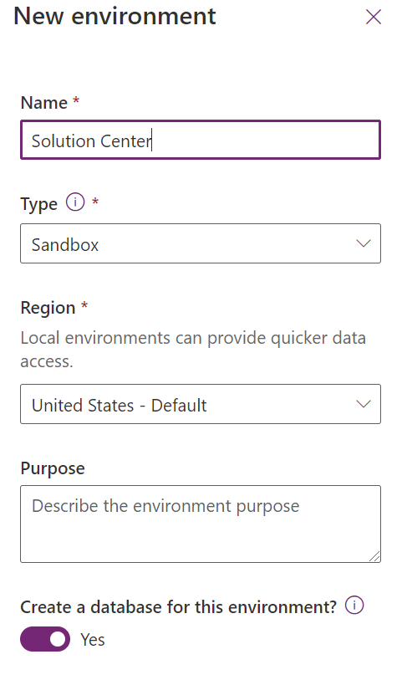
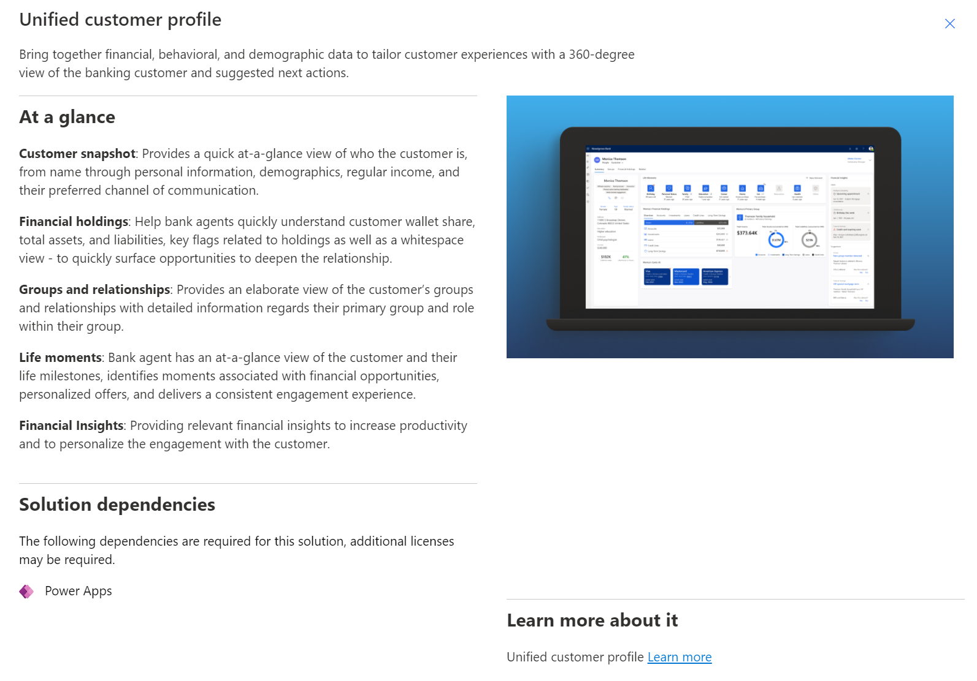
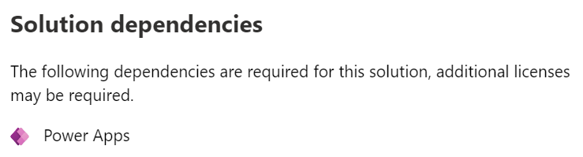
Deploy | Step 1 : Prepare Environment
Create new environment
Pre-install dependencies
Financial Services Data Model
No additional dependencies
Unified Customer Profile
Power Apps
Account and purchase Protection
Dynamics 365 Fraud Protection
Customer Onboarding
Collaboration Manager for Loans
Power Apps
Power Apps
Dynamics 365 Customer Insights (recommended)
Teams
8
Notes:
The first step to deployment is to prepare the environment.
You will need an environment with Dataverse database. So if you see the screenshot here, when you create a new environment in Power Platform Admin Center, you will have to select ‘Create a database’ for this environment <point to the screen> Also note that FSI is only available in US, UK regions for now, so you will need to select one of them as regions to be able to proceed with the deployment.
Next you will install dependencies as required. You can navigate to Solution Center, select your chosen FSI capability and view the solution dependencies as shown here <point to screenshot>

Slide 9
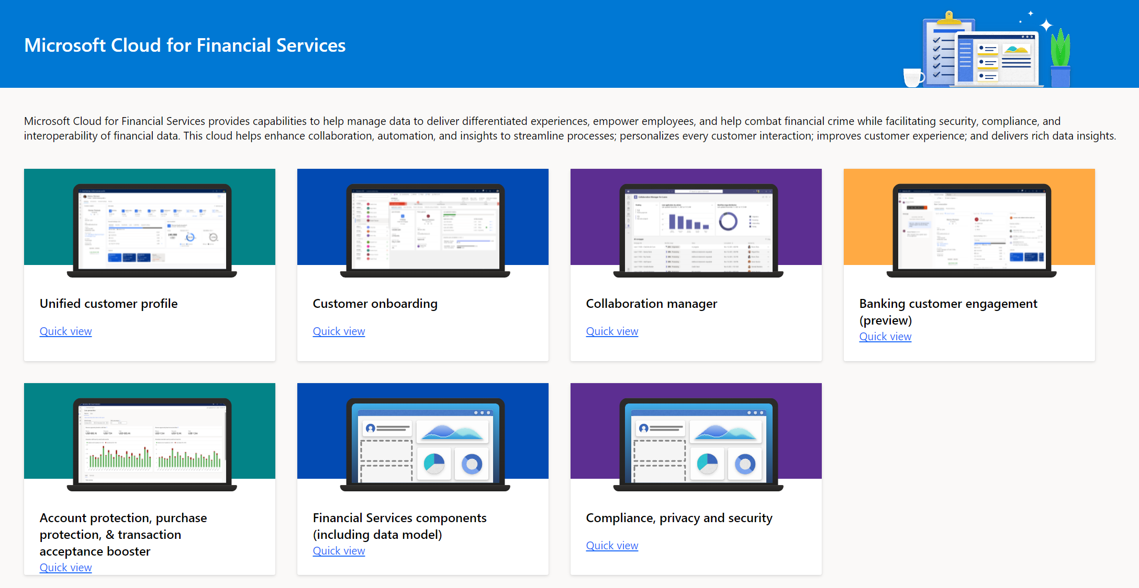
Deploy | Step 2 : Select FSI solutions
View solutions
9
Notes:
Once your environment is prepped up with a database and dependencies, you will then move to the next step to select the required FSI solutions to install. You can either choose one or many capabilities in one go, select add and kickoff the installation process

Slide 10
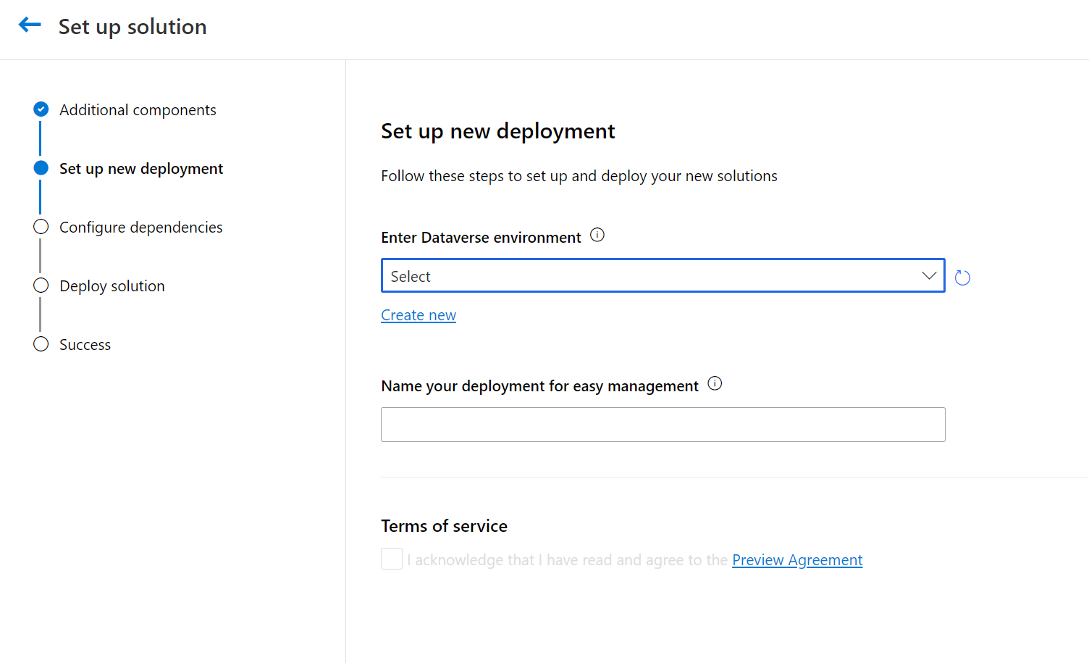
Deploy | Step 3 : Select destination
Select environment
10
Notes:
You will be prompted with the Org picker dropdown which has a list of all orgs on your tenant. If you have just created your environment and not seeing your org in the list, give it a few minutes before you retry and it should reflect there.

Slide 11
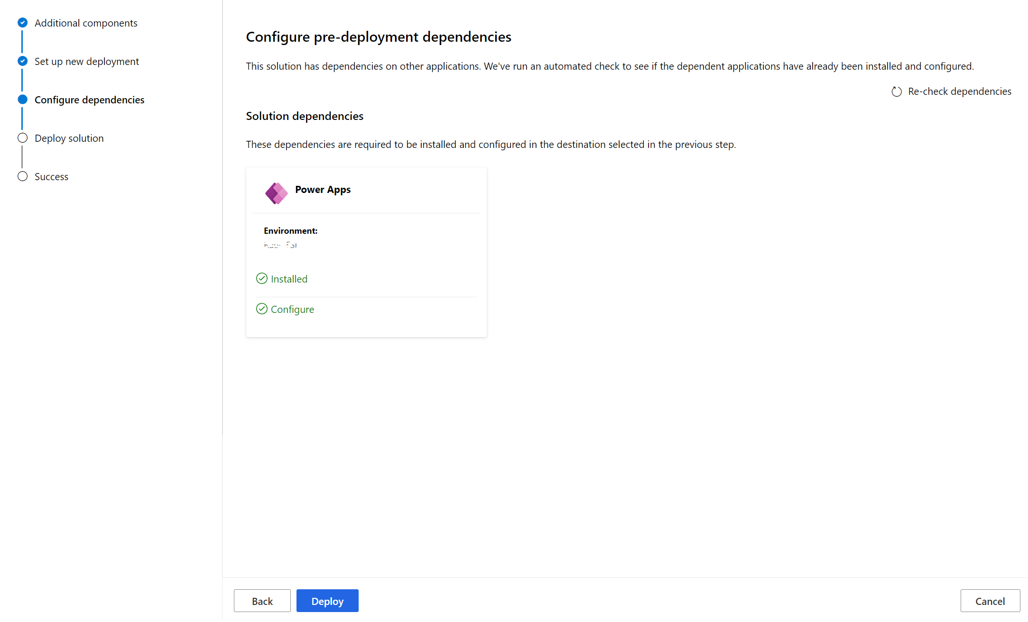
Deploy | Step 4 : Configure dependencies
Configure dependencies
11
Notes:
When you select an environment to install, the Solution Center runs a dependency check in the background to make sure you have all that you need to get the solution working. For example , here<point to screenshot> you see that the org has the Power Apps dependency pre-installed before they kicked off the installation process. Hence, you don’t see any error and can proceed.

Slide 12
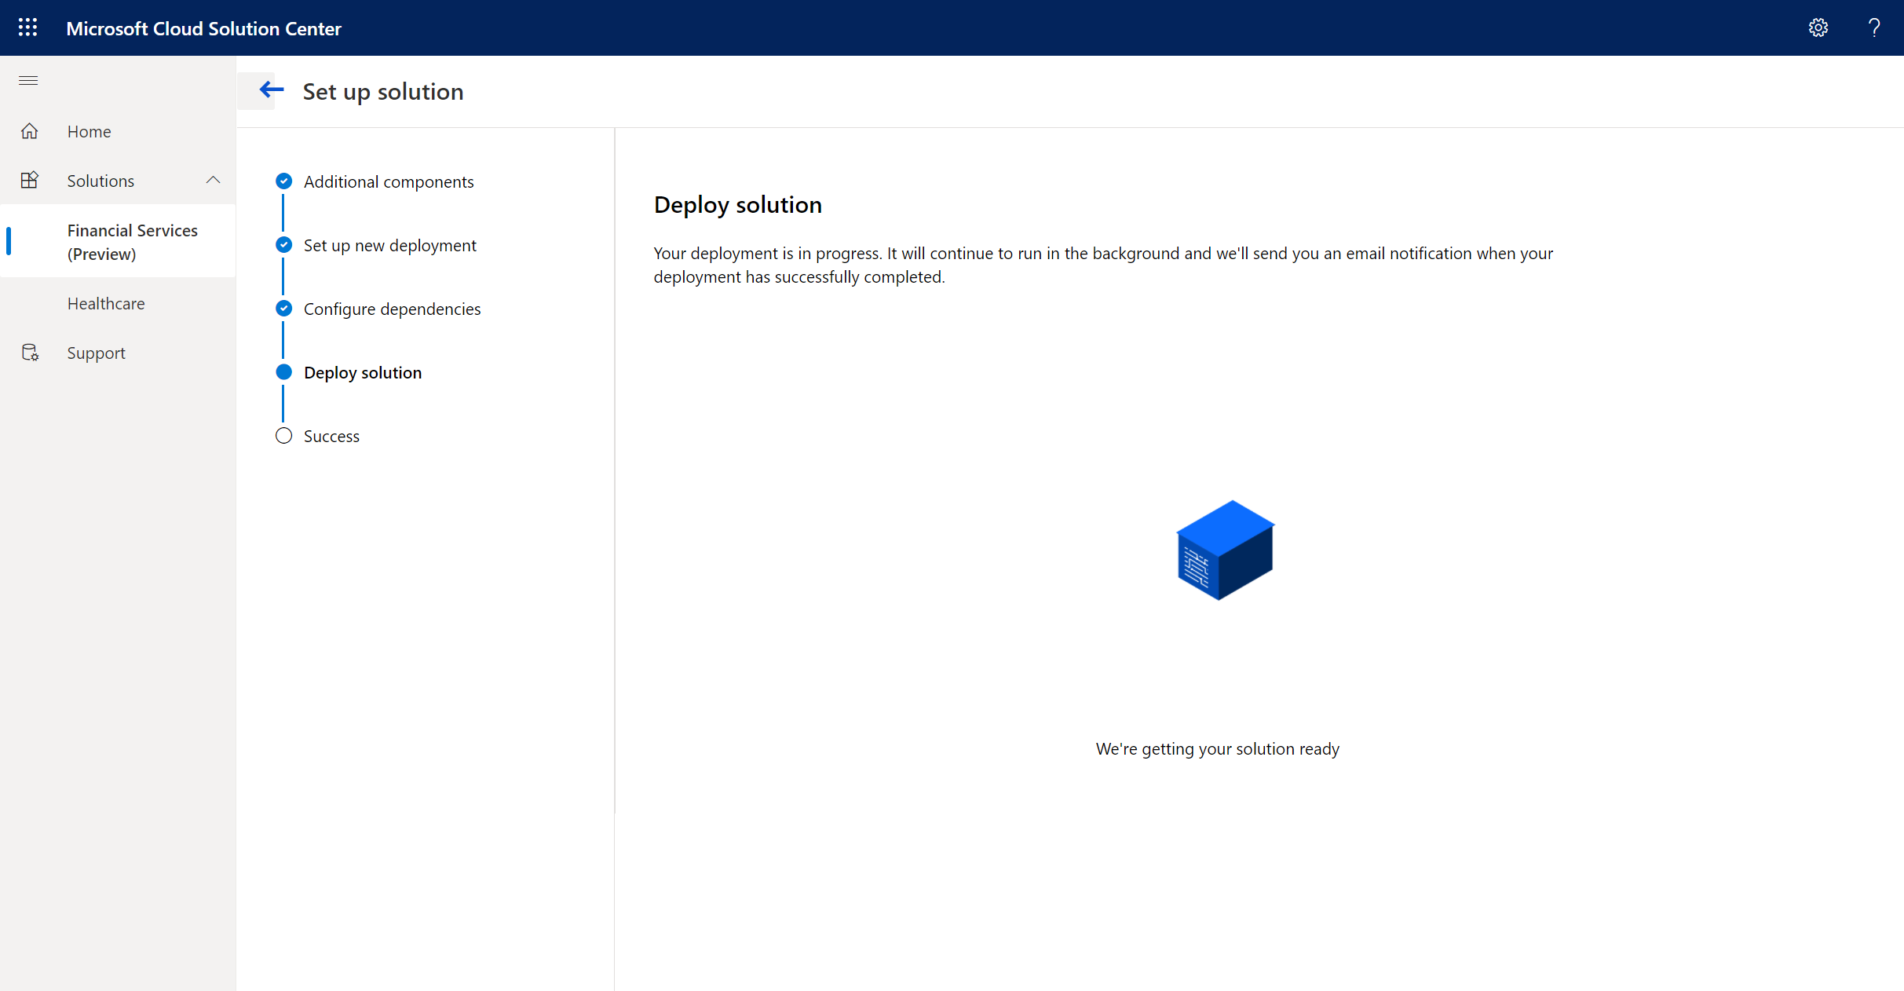
Deploy | Step 5 : Install FSI solutions
Install solutions
12
Notes:
Once the dependency checkpoint is crossed, the installation process kicks in and you will see a progress status indicating the components that are getting deployed. Once ready you should receive a confirmation status from Solution Center indicating the success or failure of the deployment.

Slide 13
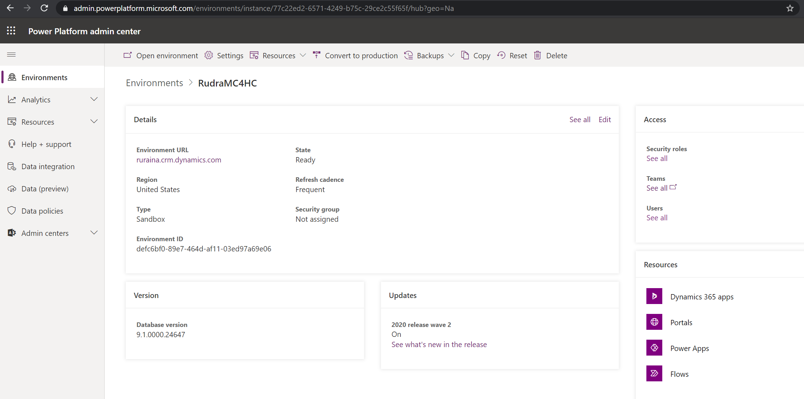
Deploy | Step 6 : Track solution status
Track solution status in Power Platform Admin Center
13
Notes:
You can also track the solution status in Power Platform Admin Center under Dynamics 365 apps section

Slide 14
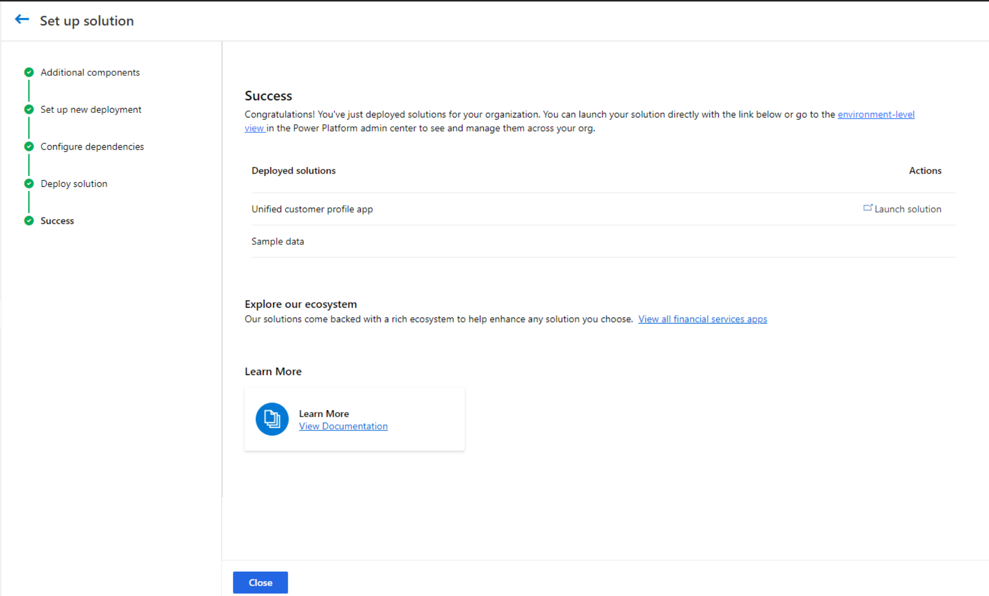
Configure | Post deployment configuration
Post deployment configurations
14
Notes:
Once the installation is complete, you can begin the post deployment solution configurations in Solution Center. In this example, we have deployed Unified Customer Profile and we can see many options such as Configure churn model as part of Customer intelligence. So you can access documentation for these configurations using the tiles here <point to screenshot> and complete your setup.

Slide 15
Configure | Post deployment solution configuration
Configure Microsoft Teams solution for collaboration
Dynamics 365 solution enhancements
Unified Customer Profile
Configure churn model as part of Customer Intelligence
Customer Onboarding
Configure sample portal
Collaboration Manager
Configure settings values
Configure Business Process Flow for Loan Onboarding
Share app with users
Assigning records to users
15
Notes:
The Post deployment solution configurations consist of enhancements across the clouds – Dynamics and M365
Here<point to lowest layer> we see the Dynamics solution enhancements possible for each of the capabilities. Like for Customer Onboarding, you can configure Business Process flows and sample portal. Similarly you can configure Teams components such as Bookings and chat for Collaboration Manager in M365.

Slide 16
Configure | Post deployment user configuration
Unified Customer Profile
Basic User
MC4FSI Basic User
Customer Onboarding
MC4FSI Basic User
Loan Manager
Collaboration Manager
Collaboration Toolkit User
Basic User
Collaboration Manager for Loans User
Loan Officer
Retail Banking – contributor
Relationship manager
Financial Intelligence user (optional for UCP and CI)
Add additional user licenses and assign security user roles in Power Platform Admin Center
16
Notes:
Now that the solution based configurations are complete, we will move on to user level configurations. Essentially assigning user licenses and appropriate security roles to the users in your enterprise. This slide shows a summary of the roles required for a user to access the core FSI capabilities. For instance, if you have deployed the Customer Onboarding solution, you will then configure your users to have <point to slide> MC4FSI basic user and Loan manager security roles.

